Slide 1

SEO Project Comprehensive SEO Audit & Optimization for Organic Traffic Growth
Sruthi Vijay | MBE12

Slide 2
Company Selection
I selected the company “www.Infosys.com” for this SEO project.
About Infosys
Founder: N.R.Narayana Murthy ,1981, headquartered in Bangalore, India
Industry: Global leader in IT services, consulting, and digital transformation
Services: Offers solutions in cloud, AI, data analytics, cybersecurity, and digital experience
Global Reach: Operates in 50+ countries, with clients across diverse sectors
Innovation & Sustainability: Known for its focus on innovation, Infosys drives sustainable digital transformation
Employee Strength: Over 300,000 employees dedicated to driving growth for global clients

Slide 3
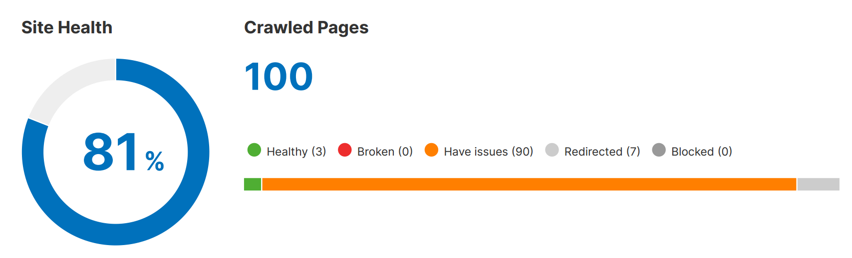
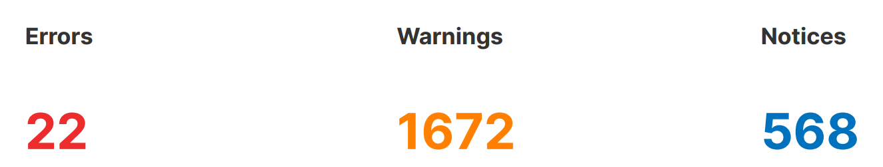
Initial Audit
SITE AUDIT
Recommendations
Review and correct hreflang tags to ensure they reference the right URLs
Optimize HTML by removing unnecessary code and comments
Add a unique H1 tag to each page, ensuring it's descriptive of the content
Implement caching strategies and set appropriate cache-control headers
Create unique meta descriptions for each page, keeping them under 160 characters
Top issues
13 hreflang conflicts within page source code
6 pages have too large HTML size
25 pages don't have an h1 heading
93 issues with uncached JavaScript and CSS files
14 pages don't have meta descriptions

Slide 4
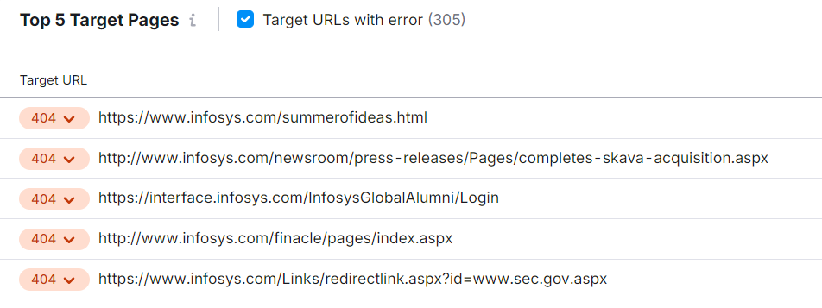
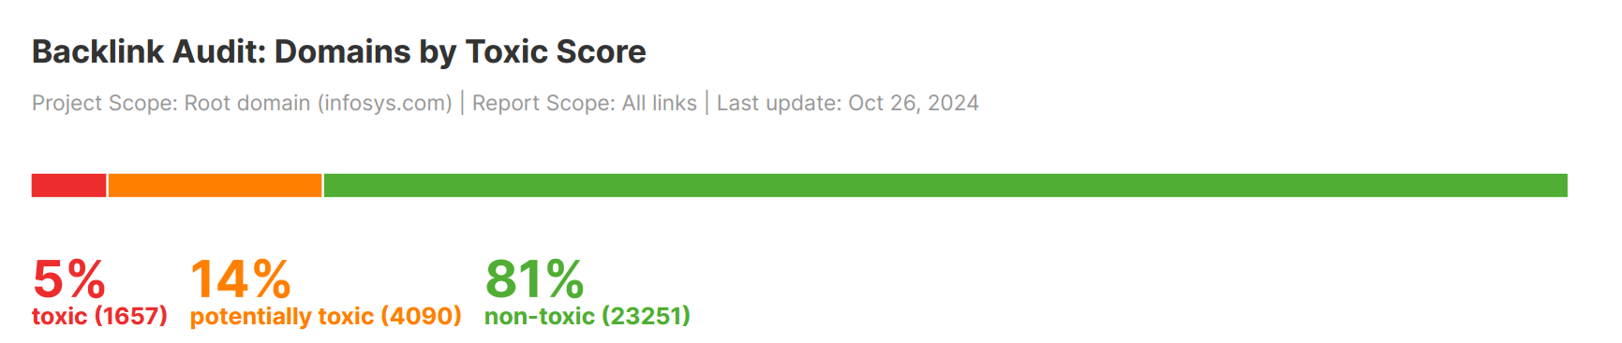
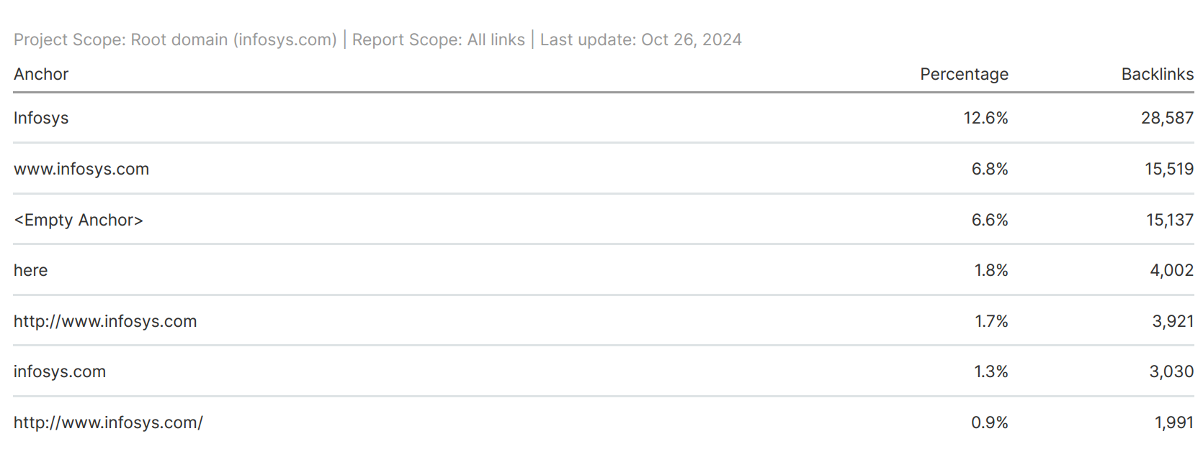
BACKLINK AUDIT
Overall Toxic Score – HIGH
Referring Domains – 28,998
new 1,452
broker 2,724
lost 1,927
Analysed Backlinks – 227,752

Slide 5
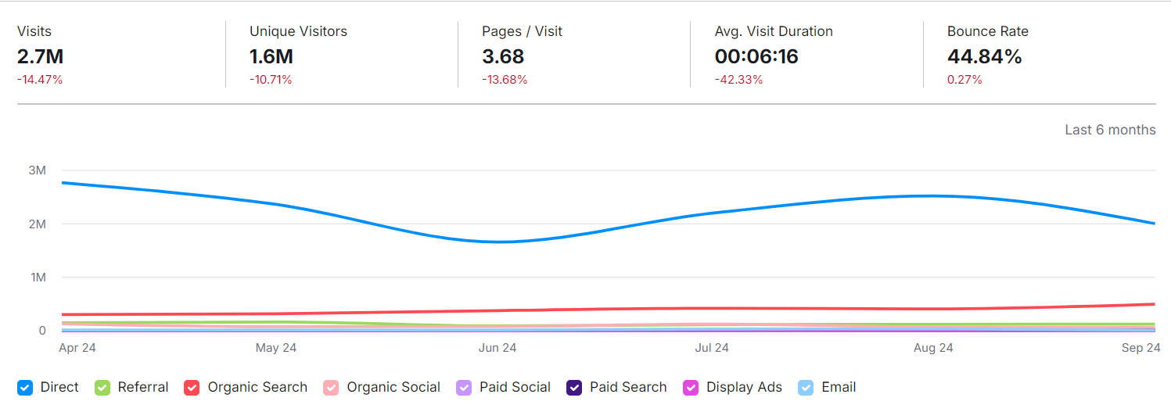
Traffic Analytics
Decline in Traffic: Visits have dropped by 14.47%, and unique visitors by 10.71%, indicating a possible loss in user interest or reach.
User Engagement: Pages per visit decreased by 13.68%, and average visit duration dropped significantly by 42.33%. This suggests users are spending less time and viewing fewer pages per session.
Bounce Rate: A slight increase (0.27%) in bounce rate, now at 44.84%, implies that more users are leaving without interaction.

Slide 6
Recommendations
Improve Content Relevance: Assess content to ensure it meets user needs and aligns with search intent to increase engagement.
Optimize User Experience: Improve site speed, structure, and design to enhance visitor retention
Enhance Organic Reach: Refine SEO and focus on high-impact keywords to attract targeted traffic.
Leverage Social Media: Increase engagement on social platforms to drive direct and referral traffic
Analyze Drop Sources: Identify and address specific pages or traffic sources with declining engagement.

Slide 7
Keyword research
Targeted keywords:
High-Volume Keywords:
"info sys": Highest search volume with 550,000, low competition, and CPC ranging up to $1.86.
"Infosys news": 74,000 searches, medium CPC between $0.60 - $1.54
Digital Transformation Keywords:
"digital transformation" and “IT digital transformation": Both have 22,200 in search volume, low competition, and a CPC of up to $1.01
Regional Keywords:
Location-Specific Keywords: Keywords like "Infosys company bangalore," "Infosys bengaluru," and "Infosys hyderabad" are low-cost with around 22,200 in search volume
"Infosys company pune" and "Infosys chennai": These keywords (with 18,100 and 8,100 in search volume, respectively) are low-cost with minimal competition

Slide 8
Career-Oriented Keywords:
"Infosys jobs for freshers": 5,400 in search volume, low CPC of up to $0.07
"Infosys springboard free courses" and "Infosys springboard courses": With 3,600 in search volume each, these keywords show a low competition and CPC
Product and Consulting Keywords:
"Infosys products" and "it consulting services": These have lower search volumes (3,600 and 2,400, respectively) but are highly relevant to Infosys’s service offerings. They show CPC values that go up to $1.26
Strategic Recommendations
Focus on Digital Transformation and Consulting Keywords
Utilize Brand and Regional Keywords
Optimize Career and Training Keywords
Capitalize on Industry-Specific Keywords for Product and Service Awareness

Slide 9
Competitor Keywords And Strategies
"t cs" - 550,000 searches, low competition
"tata consultancy services ltd" - 301,000 searches, low competition
"tcs careers" - 90,500 searches, low competition​
TCS
wipro technology" - 368,000 searches, low competition
wipro ltd company" - 74,000 searches, low competition
IT companies in pune" - 27,100 searches, low competition​
WIPRO

Slide 10
Strategic Insights
TCS: Focus on career and consulting-related keywords to leverage their low competition yet high volume in search traffic
Wipro: Emphasize technology and regional keywords to capture market segments searching for tech jobs and services in specific cities

Slide 11
On-page seo optimization audit
.
Selected Page 1: https://www.infosys.com/iki.html
Strengths:
Clear Content Structure: Well-organized sections improve user experience and SEO.
Internal Linking: Links to related content encourage further reading and reduce bounce rates.
Weakness:
Limited Keyword Targeting: Core keywords could be optimized further in titles and content.
Image Alt Text: Alt text for images may lack detail, limiting image search potential.
Suggestions
Enhanced Keyword Integration: Refine keywords in headers and meta tags.
Content Updates: Regularly add new insights to improve ranking and engagement.

Slide 12
Selected Page 2 : https://www.infosys.com/investors.html
Strengths:
Detailed Content: Provides comprehensive information for investors, which boosts engagement and credibility.
Clear Internal Linking: Multiple links to resources keep visitors on the site and enhance SEO.
Weakness:
Keyword Optimization: Titles and headers could better target investor-related keywords.
Image Alt Text: Limited descriptive alt text for images, impacting accessibility and SEO.
Suggestions
Improve Keyword Strategy: Optimize titles, meta descriptions, and headers with relevant keywords.
Enhanced Alt Text for Images: Add meaningful alt text to improve image search rankings and accessibility

Slide 13
Selected Page 3 : https://www.infosys.com/careers/
Strengths:
Clear Navigation: Organized sections make it easy to explore opportunities.
Engaging Content: Descriptions for different job roles attract potential applicants
Weakness:
Keyword Usage: Titles and meta tags could target job-related keywords more effectively..
Limited Alt Text: Images lack detailed alt text, impacting accessibility and searchability.
Suggestions
Optimize Keywords: Integrate career and job-specific keywords in headers and meta descriptions.
Detailed Alt Text: Use descriptive alt text for better accessibility and SEO.

Slide 14
Technical seo
Current technical SEO status
Performance Metrics
Performance Score: 41%
Structure Score: 81%
Fully Loaded Time: 4.9 seconds (high; ideally under 3 seconds).
Page Size: 2.10 MB with 178 requests
Key Issues
Largest Contentful Paint (LCP): 2.9s (above the ideal of 2.5s).
Total Blocking Time (TBT): 1.4s (high; ideally below 150ms).
Cumulative Layout Shift (CLS): 0.01

Slide 15
Suggestions to Improve Site and Web Page Speed:
Optimize Images and Reduce Page Size: Compress images and leverage next-gen formats (like WebP).
Minimize JavaScript: Reduce the amount of JavaScript to enhance speed and interactivity.
Improve Server Response Times: Consider better hosting options or optimizations.
Implement Lazy Loading: Load images as users scroll down to improve initial loading times.
Enhance Caching Strategies: Utilize browser caching and server-side caching to speed up repeat visits.

Slide 16
Content strategy
Pillar Content for Digital Transformation
Objective: Establish Infosys as a leader in digital transformation
Target Keywords: "digital transformation," "IT digital transformation," "IT consulting services“
Content Types:
Long-Form Guides and Whitepapers: Create comprehensive guides on topics like “The Future of Digital Transformation” and “Implementing IT Digital Transformation.”
Case Studies and Success Stories: Showcase Infosys’s successful projects, using SEO-optimized case studies to demonstrate real-world impact.
Industry Reports and Trend Analysis: Monthly or quarterly reports on digital trends will attract B2B leads.
Publishing Platforms: Blog, LinkedIn, and industry publications

Slide 17
Regional Content Hubs
Objective: Drive localized traffic and strengthen regional office visibility
Target Keywords: "Infosys company Bangalore," "Infosys Hyderabad," "Infosys Pune," etc
Content Types:
Localized Landing Pages: Dedicated pages for Infosys’s main offices, highlighting regional services, projects, and job openings.
Location-Specific Blogs: Articles about industry events, partnerships, or community involvement in each city.
Employee Testimonials: Showcases of local employees’ stories or achievements in each region to engage talent and highlight office culture
Publishing Platforms: Infosys website, Google My Business, and region-specific social media pages

Slide 18
Career and Talent Development
Objective: Attract talent, particularly early-career professionals.
Target Keywords: "Infosys jobs for freshers," "Infosys internship," "Infosys springboard courses“
Content Types:
Career Blog Series: Articles and videos covering "Life at Infosys," with content tailored to job seekers, featuring early-career development programs, tips for interviews, and success stories of recent hires
Virtual Tour and Training Content: Create videos and webinars on Infosys’s Springboard program and learning modules for prospective hires.
Interactive Q&A Sessions: Monthly webinars or LinkedIn Live events where recruiters answer questions and provide insights into Infosys’s culture.
Publishing Platforms: Blog, LinkedIn, YouTube, and campus recruitment portals.

Slide 19
Product and Service-Specific Content
Objective: Promote Infosys’s consulting services and digital products to B2B clients
Target Keywords: "Infosys products," "IT consulting services," "Infosys business solutions“
Content Types:
Product-Focused Landing Pages: Dedicated pages for each major service line or product, optimized to answer common client pain points.
Solution Videos: Short, client-focused videos that showcase the features, benefits, and use cases of Infosys’s core products and solutions.
Email Newsletters: Monthly insights on product updates, industry solutions, and case studies.
Publishing Platforms: Website, YouTube, email newsletters, and gated content (e.g., downloadable guides).

Slide 20
Thought Leadership on Emerging Technology and Industry Trends
Objective: Build authority in key areas such as AI, cloud computing, and blockchain
Target Keywords: "Infosys news," "digital business transformation," "IT solutions”
Content Types:
Executive Insights: Blog articles and LinkedIn posts authored by Infosys’s executives on current tech trends.
Webinars and Virtual Events: Monthly webinars where Infosys experts discuss and forecast trends in tech and consulting.
Collaborative Articles: Partner with industry influencers and publications to create joint content on emerging trends.
Publishing Platforms: Blog, LinkedIn, industry sites, and tech event platforms

Slide 21
Infosys Brand Awareness Campaigns
Objective: Strengthen Infosys’s brand perception and engage a broad audience
Target Keywords: "info sys," "about Infosys," "Infosys company“
Content Types:
Brand Storytelling Videos: Videos that tell the story of Infosys’s journey, core values, and impact.
Press Releases: For major announcements, achievements, partnerships, and recognitions, which can be optimized for search and shared across media.
Social Media Campaigns: Monthly themes focused on different aspects of Infosys’s impact and community involvement, using visually engaging content.
Publishing Platforms: Social media, Infosys blog, and press outlets

Slide 22
Timeline and Content Calendar Suggestions
Weekly:
Social Media Posts: Region-specific highlights, culture posts, quick industry insights.
Blog Articles: Regular posts on digital transformation, career advice, and product features.
Monthly:
Webinars: Live events on digital trends, talent Q&As, and product showcases.
Newsletters: Digest with recent blog articles, upcoming events, and product highlights
Quarterly:
Industry Reports: In-depth digital transformation reports and thought leadership articles.
Case Studies: New client case studies and project spotlights.

Slide 23
Off-page seo
Link-Building Strategies
Guest Blogging: Identify tech and business publications (e.g., TechCrunch, CIO.com, Forbes Tech) for thought leadership content on topics like digital transformation and IT consulting.
Influencer Partnerships: Collaborate with tech influencers and industry leaders on LinkedIn, YouTube, and Twitter to expand reach. Examples include partnering with tech analysts or speakers at industry conferences.
Directory Submissions: List Infosys in relevant directories like Clutch.co, G2, and industry-specific directories for IT services. This improves visibility and provides authoritative backlinks.

Slide 24
Social Media Engagement
Content Promotion: Share consistent, informative content on LinkedIn and Twitter, leveraging platforms like LinkedIn Pulse for articles and Twitter Threads for quick insights on trending topics.
Webinars and Live Q&A Sessions: Host regular Q&A sessions and webinars on emerging technologies like AI, data analytics, and digital transformation, engaging the target audience in real time.
Community Engagement: Actively participate in LinkedIn groups, Reddit’s technology and consulting subreddits, and industry forums like Stack Overflow to build authority and foster discussions.

Slide 25
Online Reputation Management
Review Management: Monitor and respond to reviews on platforms like Glassdoor, Indeed, and Google My Business to enhance brand image.
Public Relations and Press Releases: Issue press releases on reputable sites like PR Newswire and industry-specific news platforms to communicate major updates, partnerships, and innovations.
Thought Leadership: Publish whitepapers and insights on relevant topics and share these on knowledge platforms like ResearchGate and Medium to boost credibility.
Actionable Opportunities
Guest Blogging: Target tech-focused blogs and IT consulting forums for guest posts.
Influencer Partnerships: Collaborate with tech event speakers and LinkedIn influencers in consulting.
Directory Submissions: Submit Infosys to credible business directories and software comparison sites.

Slide 26
Project outcome
Site and Backlink Audit: Address technical issues, optimize HTML, and manage toxic backlinks.
Traffic & Engagement Improvements: Boost site speed, content relevance, and user experience.
Keyword Strategy and On-Page SEO: Target high-impact keywords and enhance on-page SEO elements.
Content & Link-Building Strategy: Develop pillar content, regional hubs, and build authoritative backlinks.
Technical SEO Enhancements: Improve site speed, mobile responsiveness, and server optimization.

Slide 27
conclusion
This SEO project aims to boost Infosys’s online visibility by resolving technical issues, enhancing keyword strategy, and improving content relevance. By strengthening on-page, off-page, and technical SEO, we expect increased organic traffic, better engagement, and a stronger brand presence.

Slide 28
Thank you!

